Slide 1
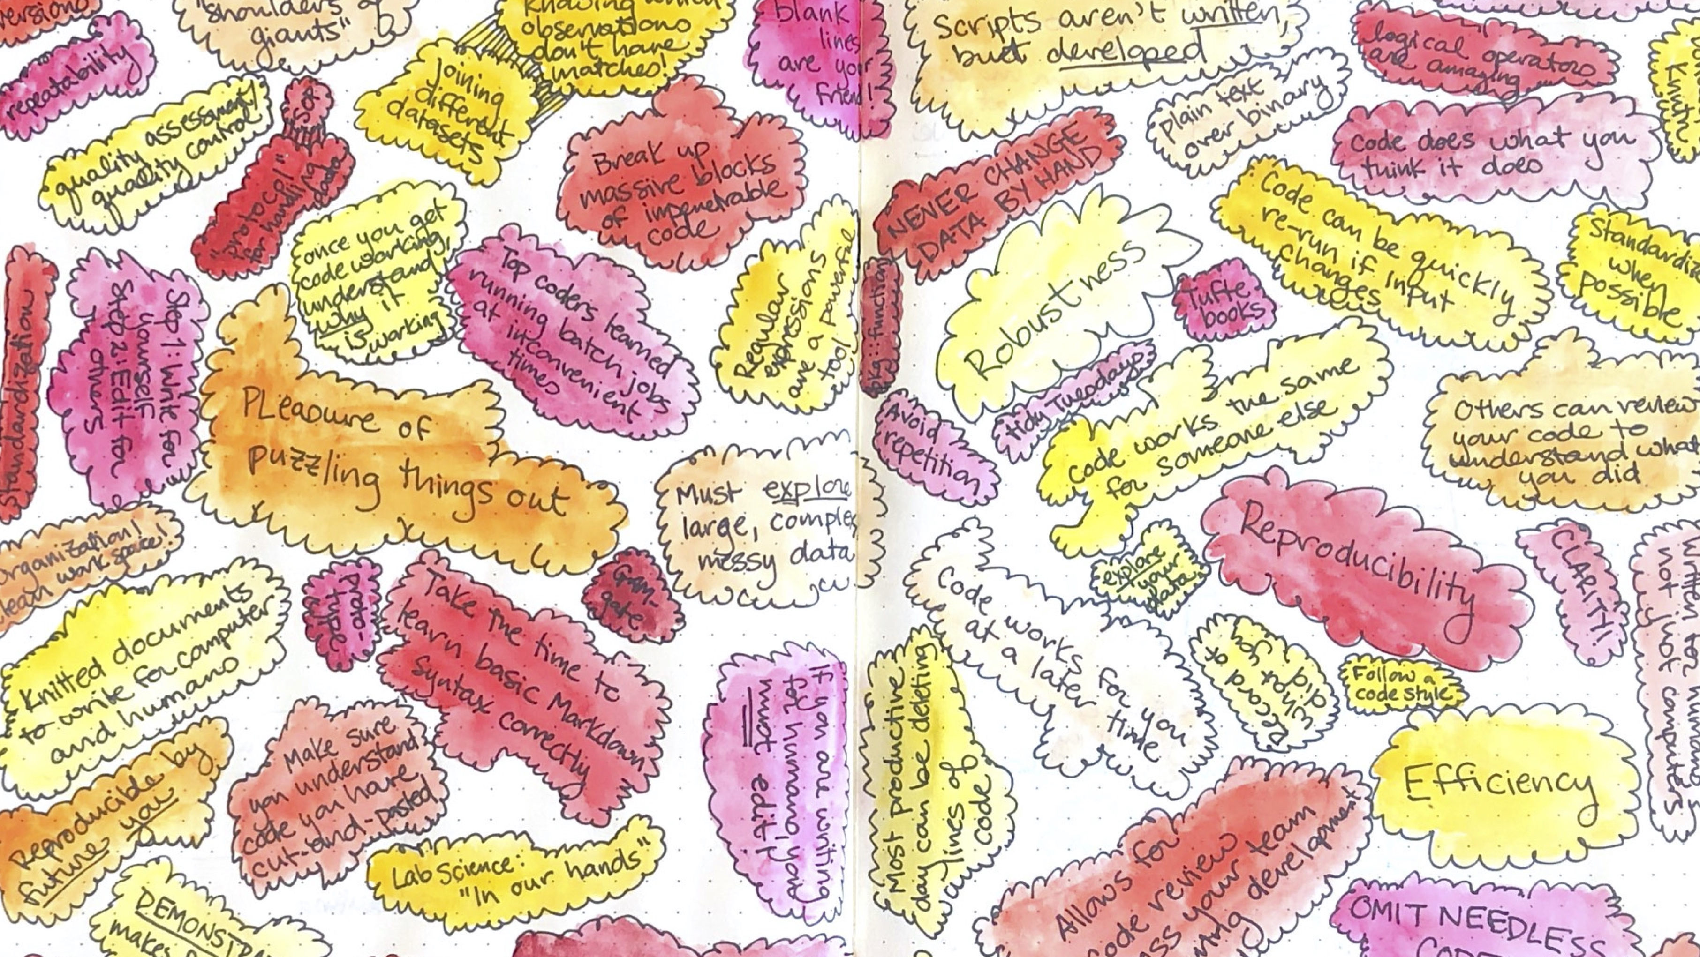
Rigor and Reproducibility in Coding
Brooke Anderson, Colorado State University

Slide 2


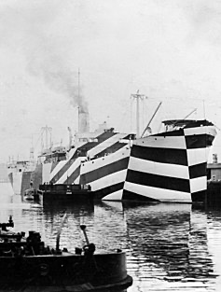

Write code for computers. Rewrite it for humans.

Slide 3
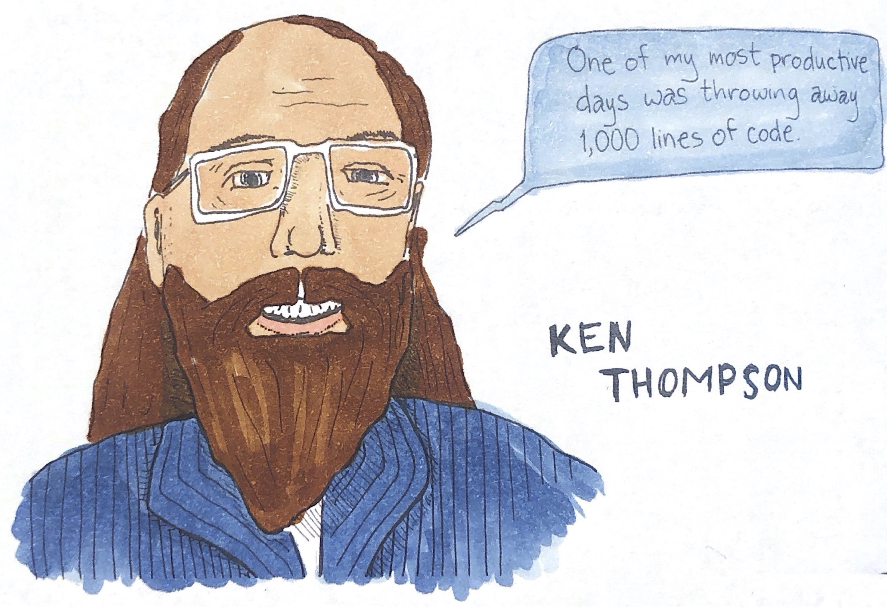
Omit needless code

Slide 4
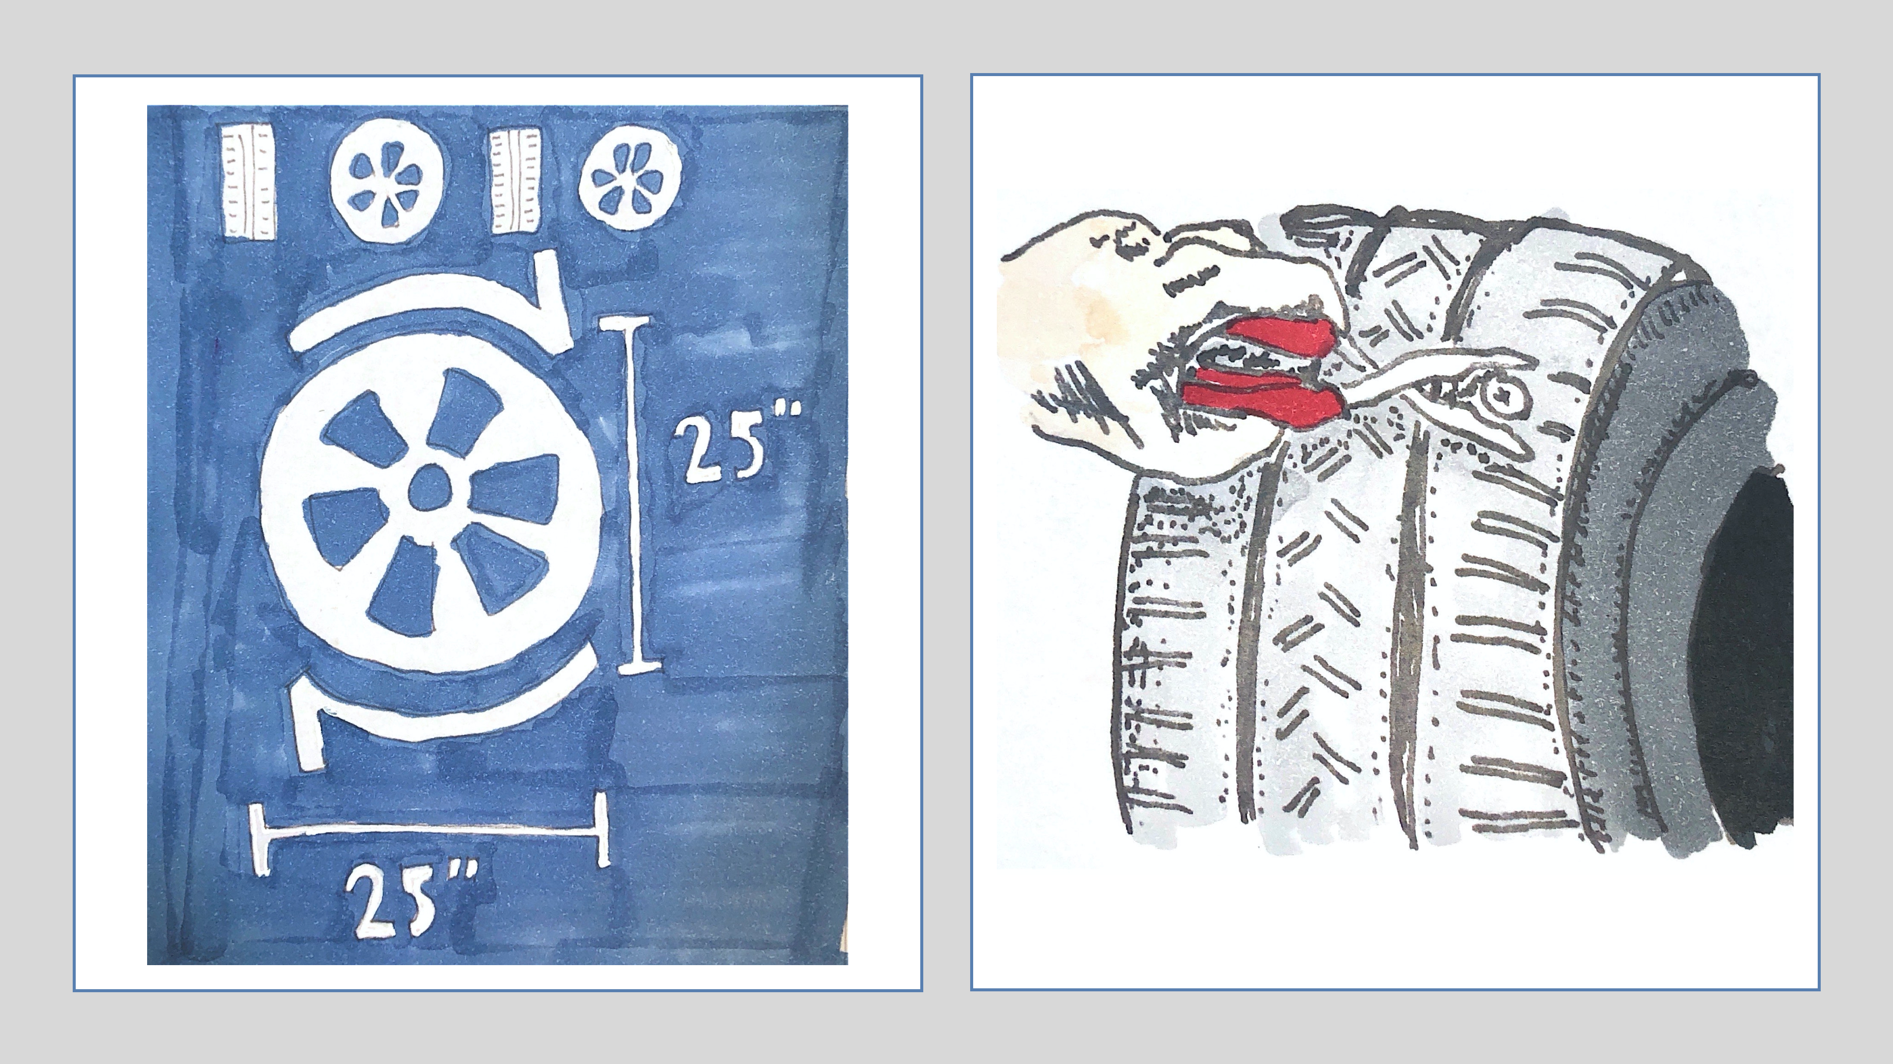
Don’t reinvent the wheel… …but do understand how it works

Slide 5
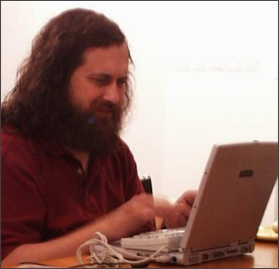


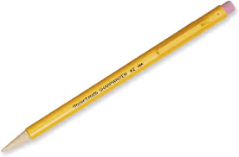

Find your favorite tools. Learn to use them well.

Slide 6
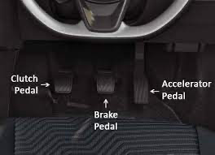
Organize, consistently

Slide 7
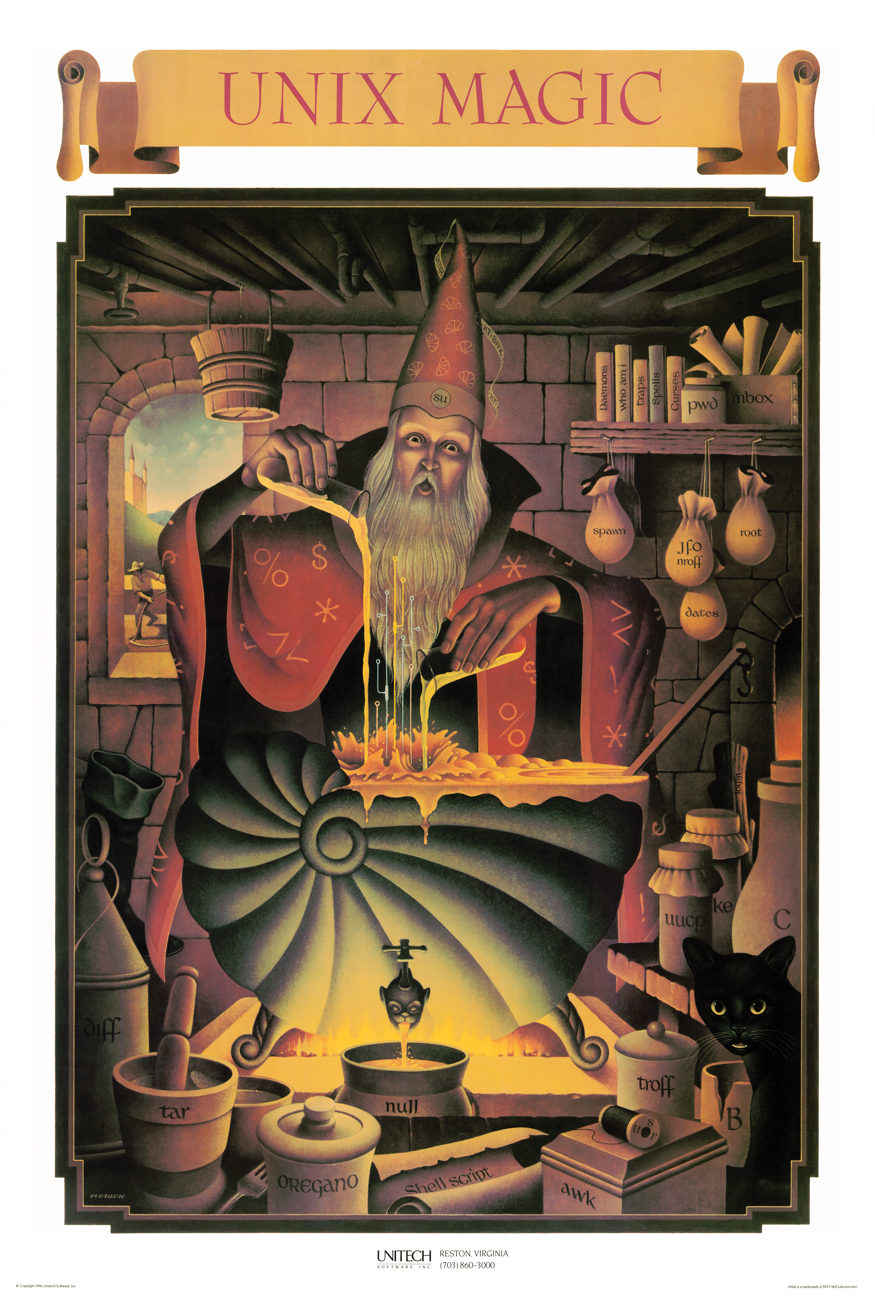
Learn some magic

Slide 8
All of a sudden my code doesn’t work, and I haven’t changed a thing!

Slide 9
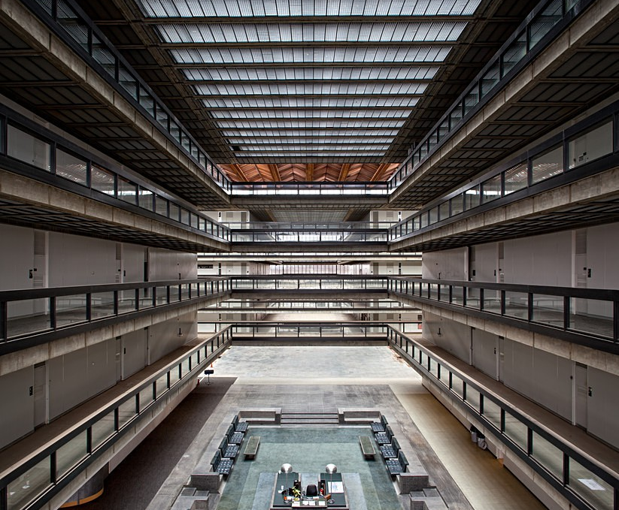
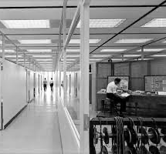
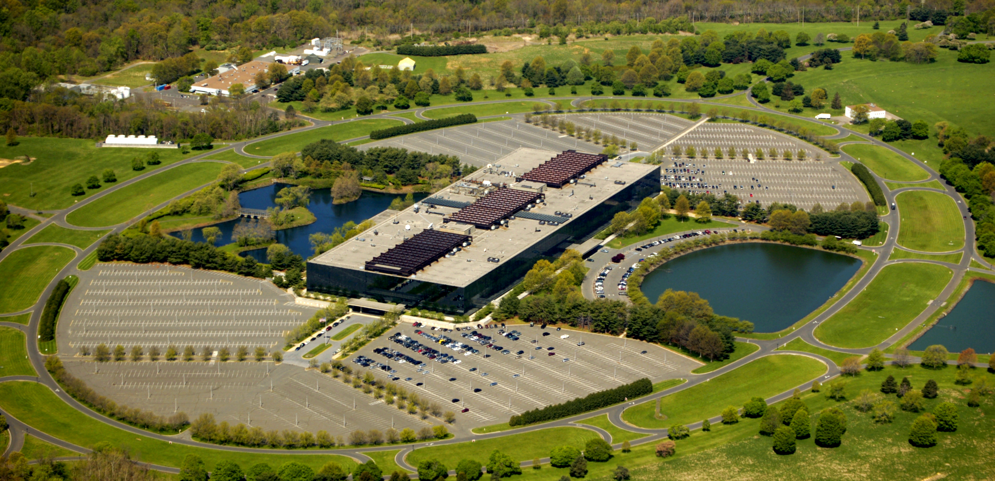
Bell Labs

Slide 10
Computational reproducibility
If you start from the same materials, you can get the same results
Who might reproduce your code? Colleagues in your research group, reviewer, reader, you in the future
“Reproducibility” is both binary and continuous:
Binary: Can you recreate the results from the same original data?
Continuous: How easy is it to recreate the results? How easy is it to understand what you did? Can you adapt and extend your approach? Can you and others critically evaluate or check it to improve the rigor? Can it serve as a demonstration for others, not just an analysis for you?

Slide 11
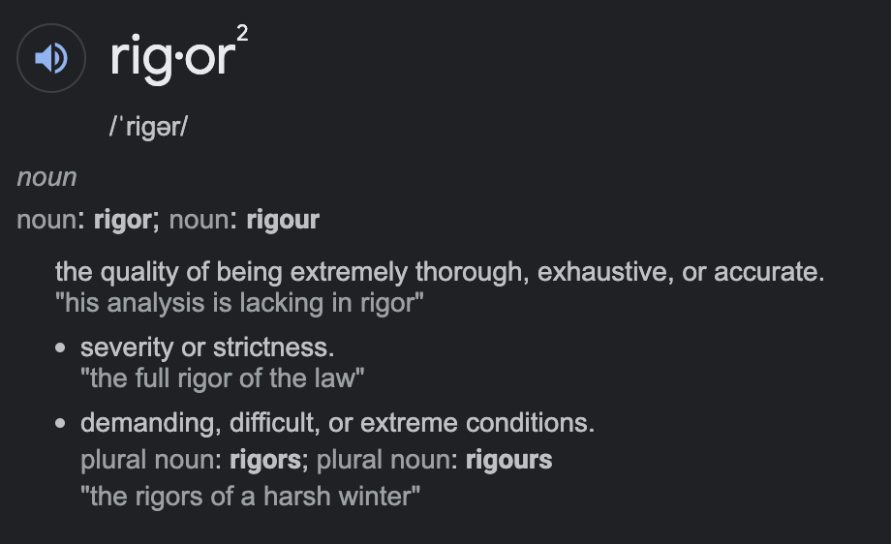
Rigor

Slide 12
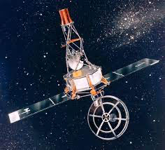

Computational rigor

Slide 13
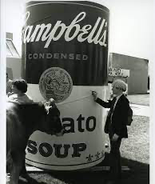
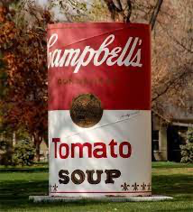
Efficiency
“This work was created by the Department of Art in 1981 in association with the exhibition Warhol at Colorado State University and according to the specifications and directions of Andy Warhol. Upon his arrival in Fort Collins in September of 1981, Warhol signed the work.”

Slide 14
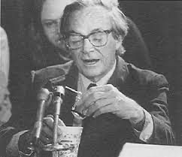
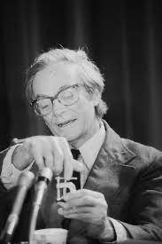

Demonstration
“The public saw with their own eyes how science is done, how a great scientist thinks with his hands, how nature gives a clear answer when a scientist asks her a clear question.”
– Freeman Dyson, on Richard Feynman’s demonstration of O-rings in Presidential Commission for the space shuttle Challenger disaster

Slide 15
Suggested resources to learn more
Google R code style guide: https://google.github.io/styleguide/Rguide.html
Articles:
Example of reproducible paper: A. Gasparrini. 2013. Modeling exposure–lag–response associations with distributed lag non-linear models. Statistics in Medicine.
H. Wickham. 2014. Tidy Data. Journal of Statistical Software.
Organizing research projects
Books available online:
R for Data Science, Wickham and Grolemund, https://r4ds.had.co.nz/
Geocomputation with R, Lovelace et al., https://geocompr.robinlovelace.net/
Data Visualization, Healy, https://socviz.co/
Text Mining with R, Silge and Robinson, https://www.tidytextmining.com/
Rmarkdown, The Definitive Guide, Xie et al., https://bookdown.org/yihui/rmarkdown/
Other books:
Reproducible Research with R and RStudio, Gandrud
Edward Tufte visualization books
Anything on regular expressions
Introductory Unix / shell coding books
Packages to learn well:
tidyverse suite of packages, including dplyr, purrr, tidyr, stringr, forcats, and lubridate
For spatial data, sf
For visualization, ggplot2 extensions, htmlwidgets, ggrepel

